Slide 1
Seminar Presentation CS5800 Spring 2024
Zhengyan Hu - 485.Max Consecutive Ones
Yin Sun - 200. Number of Islands
Dongyin Li - 2646. Minimize the Total Price of the Trips

Slide 2
485.Max Consecutive Ones
Given a binary array nums, return the maximum number of consecutive 1's in the array.
Example 1:
Input: nums = [1,1,0,1,1,1]
Output: 3
Explanation: The first two digits or the last three digits are consecutive 1s. The maximum number of consecutive 1s is 3.
Example 2:
Input: nums = [1,0,1,1,0,1]
Output: 2

Slide 3
Traversal Once
Dynamic Programming

Slide 4
Traversal Once
nums = [1,1,0,1,1,1]
max_one = 0
max = 0

Slide 5
Traversal Once
nums = [1,1,0,1,1,1]
max_one = 0 + 1
max = 0

Slide 6
Traversal Once
nums = [1,1,0,1,1,1]
max_one = 0 + 1 + 1
max = 0

Slide 7
Traversal Once
nums = [1,1,0,1,1,1]
max_one = 0 + 1 + 1 = 2
max = max(max,max_one) = 2
0 2
max_one = 0

Slide 8
Traversal Once
nums = [1,1,0,1,1,1]
max_one = 0 + 1
max = 2

Slide 9
Traversal Once
nums = [1,1,0,1,1,1]
max_one = 0 + 1 + 1
max = 2

Slide 10
Traversal Once
nums = [1,1,0,1,1,1]
max_one = 0 + 1 + 1+ 1
max = 2

Slide 11
Traversal Once
nums = [1,1,0,1,1,1]
end
max_one = 0 + 1 + 1 + 1 = 3
max = 3

Slide 12
Dynamic Programming
Input:
1 | 1 | 0 | 1 | 1 | 1
DP:
1 | 2 | 0 | 1 | 2 | 3
return largest value
0 = 0
1= DP[i-1] + 1
DP[i] = {

Slide 13
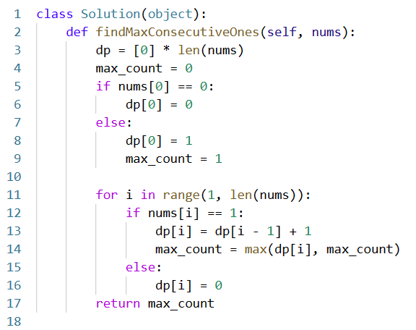
Code

